Slide 1

Employee Management System
Presented By
J.B. Sri Keerthi
M. Jahnavi

Slide 2
Agenda (This should be the PPT flow)
Objective of the Project
ER Diagram and schema explanation
Key analysis questions (use cases)
SQL query results with screenshots or summaries
Final business insights and recommendations
Conclusion (Key finding overall)
Q&A Slide
Your Experience/Challenges working on SQL – Data Analysis Project.

Slide 3
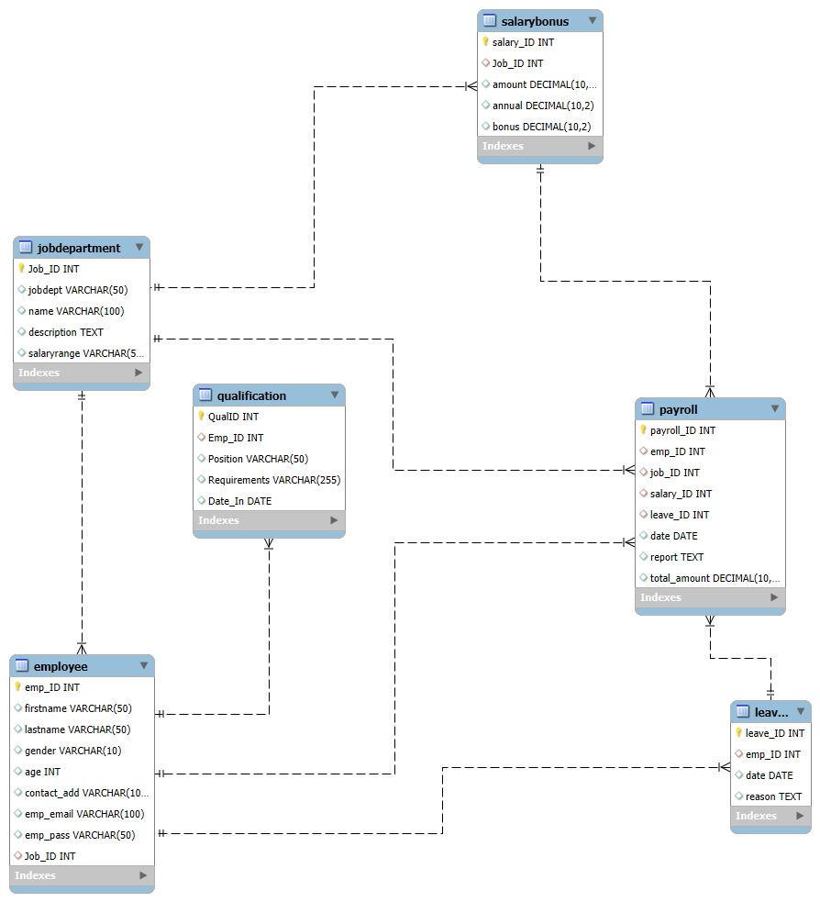
ER Diagram and Schema Explanation

Slide 4




Employees Table
Job Department Table
Leaves Table
Qualifications Table
Payroll Table
Salary Bonus Table

Slide 5
Key Analysis Questions
Which department have the highest number of employees?
What is the average salary per department?
What is the average salary range per department ?
Which job roles offer the highest salary?
Which year had the most employees taking leaves?
What is the average number of leave days taken by its employees per department?
Which department receives the highest total bonuses?
What is the average value of toal_amount after considering leave deductions?

Slide 6

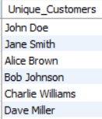

How many unique employees are currently in the system?
Query
Output

Slide 7
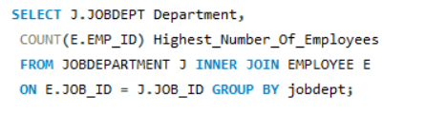
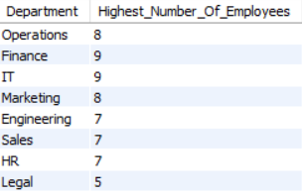
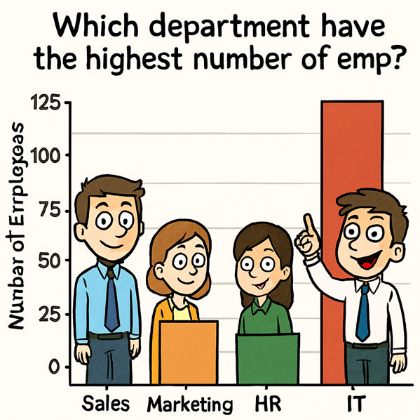
Which department have the highest number of employees?
Output
Query

Slide 8
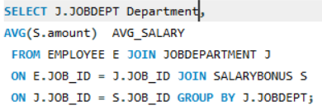
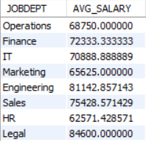
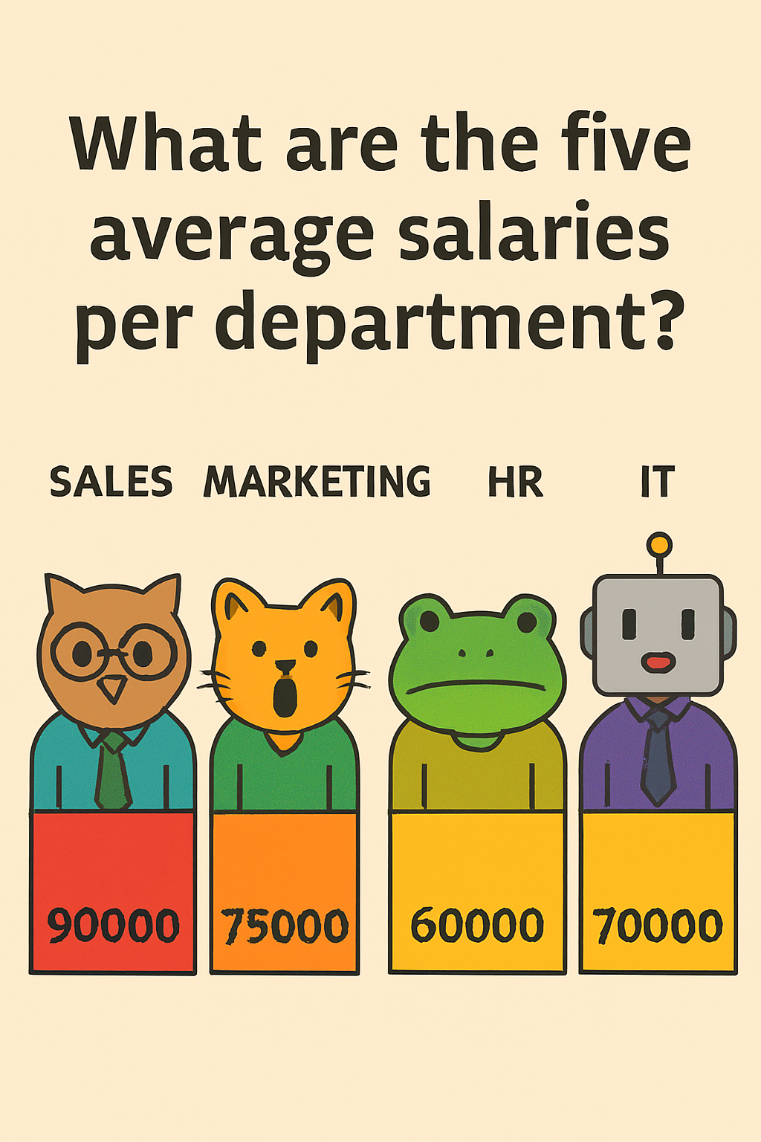
What is the average salary per department?
Query
Output

Slide 9
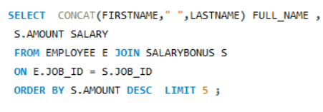
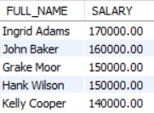
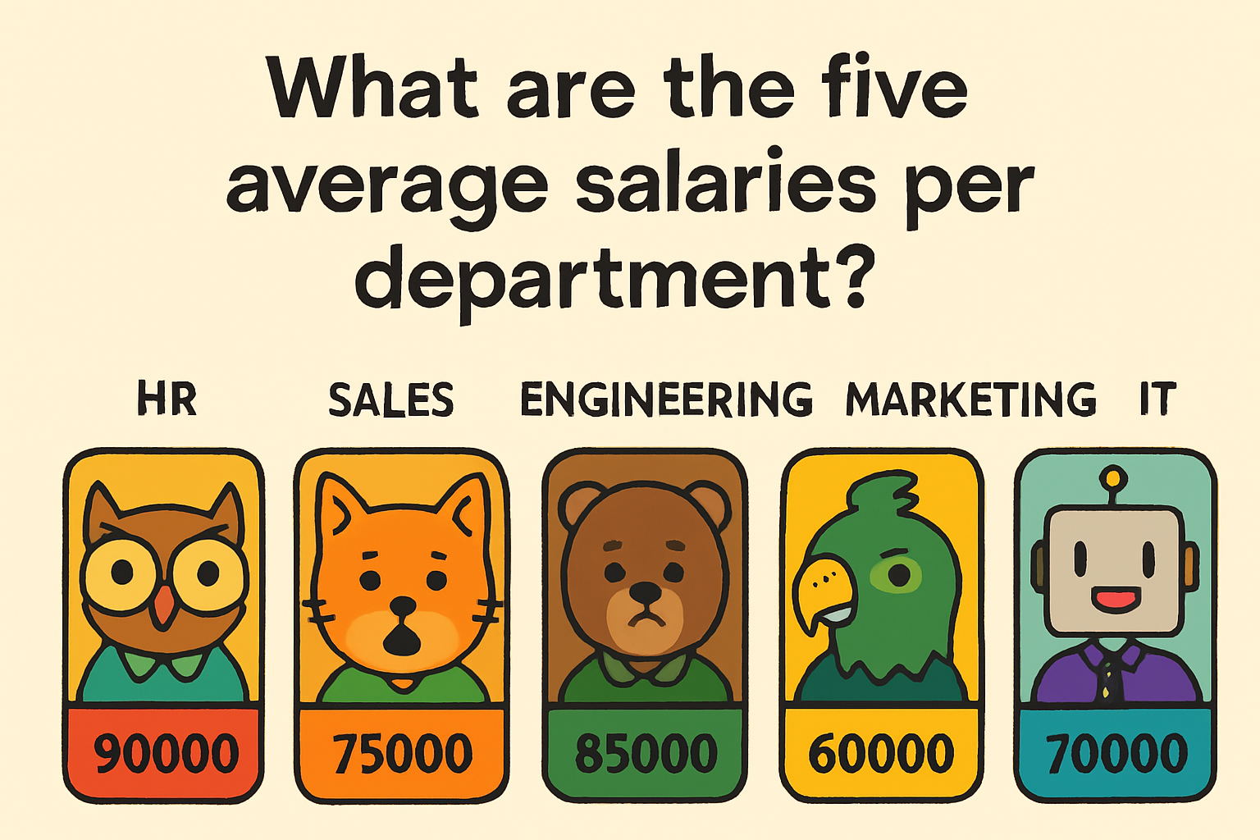
Who are the top 5 highest-paid employees?
Query
Output

Slide 10


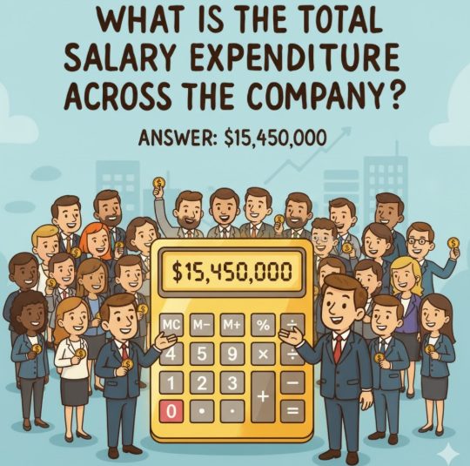
What is the total salary expenditure across the company?
Query
Output

Slide 11

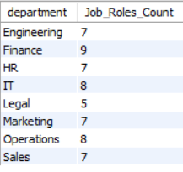
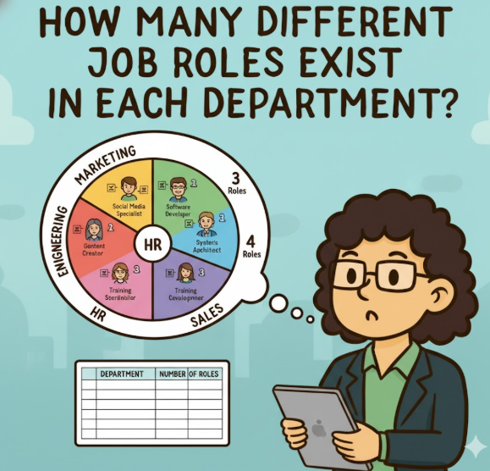
2. JOB ROLE AND DEPARTMENT ANALYSIS How many different job roles exist in each department?
Query
Output

Slide 12
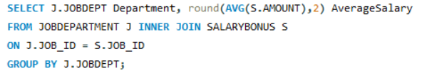
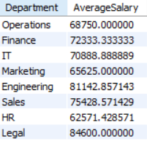

What is the average salary range per department?
Query
Output

Slide 13

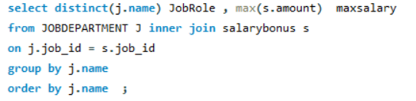
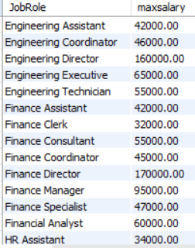
Which job roles offer the highest salary?
Query
Output

Slide 14
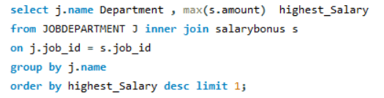

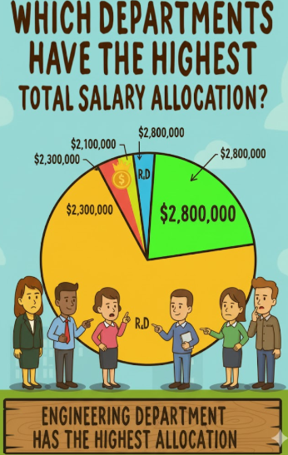
Which department have the highest total salary allocation?
JobRole
Output

Slide 15
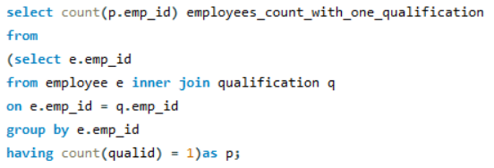


3. QUALIFICATION AND SKILLS ANALYSIS How many employees have at least one qualification listed?
Query
Output

Slide 16
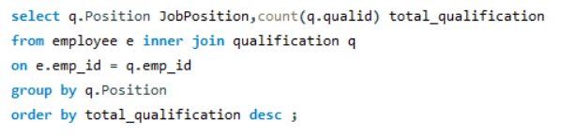
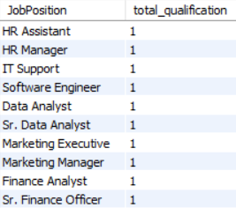
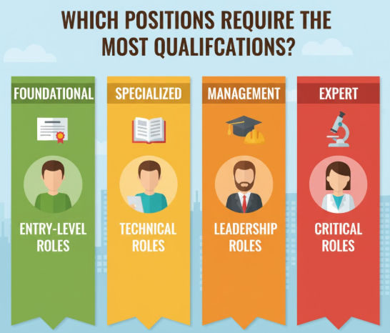
Which positions require the most qualifications?
Query
Output

Slide 17
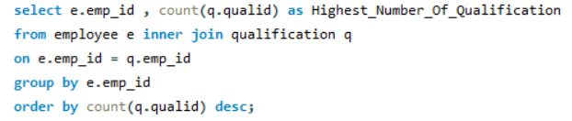
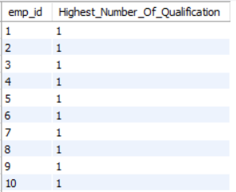

Which employees have the highest number of qualifications?
Query
Output

Slide 18
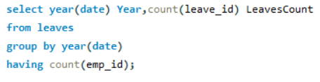


4. LEAVE AND ABSENCE PATTERNS Which year had the most employees taking leaves?
Query
Output

Slide 19
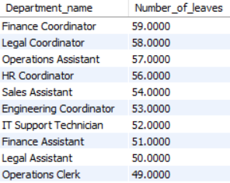
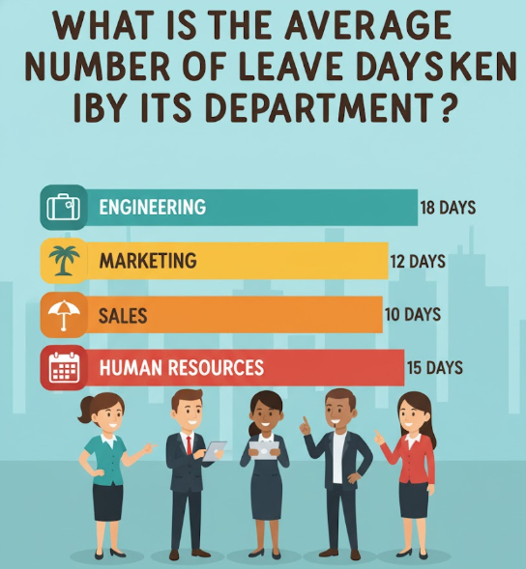
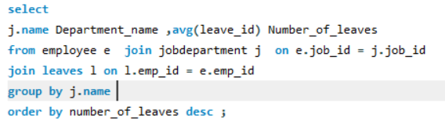
What is the average number of leave days taken by its employees per department?
Query
Output

Slide 20
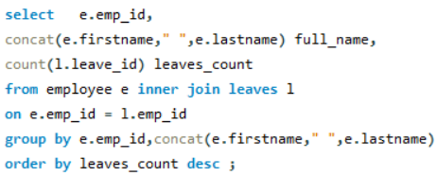
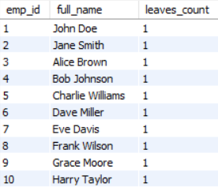

Which employees have taken the most leaves?
Query
Output

Slide 21



What is the total number of leave days taken company-wide?
Query
Output

Slide 22
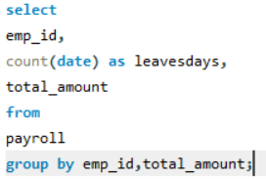
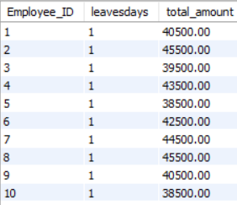
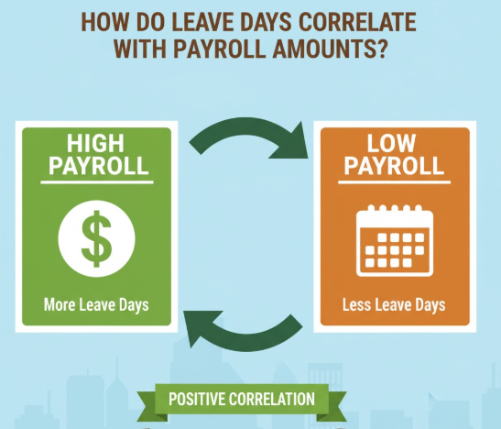
How do leave days correlate with payroll amounts?
Query
Output

Slide 23
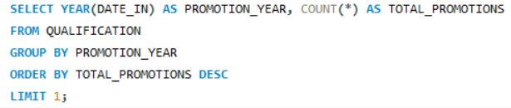


Which year had the highest number of employee promotions?
Query
Output

Slide 24
Conclusion (Key Findings Overall)
The organization shows strong salary allocation towards strategic departments.
Certain departments demonstrate high leave usage, which could affect productivity.
Qualification-rich roles correlate with higher salaries, emphasizing the value of upskilling.

Slide 25

THANK YOU

